Slide 1
ECE4300.02 Group A: A brief Presentation of Our YOLOv5 project
By: Nicholas Garcia, Michael Guillermo, Danny Manzo, and Arthur Wang

Slide 2
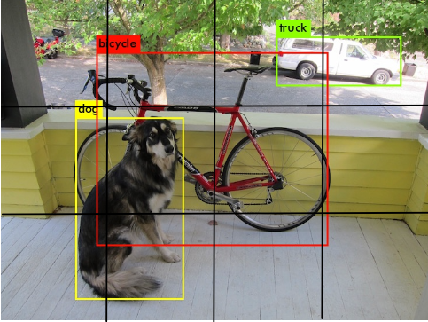
What is YOLO?
Created by Joseph Redmon in 2015
One of the most popular models for object detection
Uses grid cells and a convolutional neural network to detect and locate objects in a given input
Wha

Slide 3
Our Laptop Specifications: Michael
Michael
CPU - 12th Gen Intel(R) Core(TM) i7-1260P 2.10 GHz
GPU – Intel(R) Iris(R) Xe Graphics
Memory – 16 GB

Slide 4
Our Laptop Specifications: Nicholas
Nicholas
CPU - Intel(R) Core (TM) i5-8265U @ 1.60GHz
GPU – Intel(R) UHD Graphics
Memory – 8 GB

Slide 5
Our Laptop Specifications: Danny
Danny
CPU - Intel(R) Core(TM) i7-8750H CPU @ 2.20GHz, 2208 MHz, 6 Core(s), 12 Logical Processor(s)
GPU1 – NVIDIA GeForce GTX 1050 Ti (4 GB)
GPU2 – Intel(R) UHD Graphics 630
Memory – 32 GB DDR4 (2667 MHz)

Slide 6
Our Laptop Specifications: Arthur
Arthur’s Laptop: ASUS Zephyrus G14 GA401 (2021)
CPU: AMD Ryzen 9 5900HS – 8 Cores, 16 Threads
GPU: NVIDIA Geforce RTX 3060 (6GB w/ 60W)
GPU2: AMD Radeon Graphics
Memory: 16GB (3200Mhz, DDR4)
Test 1: CPU Only
Test 2: With Nvidia RTX 3060

Slide 7
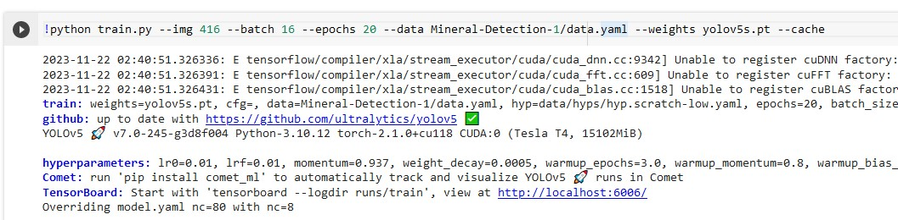
Common Parameters
Yolo Model: Yolov5s.pt
(second smallest of the five basic models)
IMG = 640
Image Size -> 640 by 640
Batch = 16
Batch Size -> number of images per batch
Epoch = 10
Number of epochs refer to total number of training samples in a batch.

Slide 8
Demo video (by Arthur Wang)

Slide 9
Results

Slide 10
Time To train (in hours)
1- CPU - 12th Gen Intel(R) Core(TM) i7-1260P 2.10 GHz – CPU ONLY
2- AMD Ryzen 9 5900HS – 8 Cores, 16 Threads - CPU ONLY
3 - AMD Ryzen 9 5900HS – 8 Cores, 16 Threads* w/NVIDIA Geforce RTX 3060
4 - Intel(R) Core(TM) i7-8750H CPU @ 2.20GHz, 2208 MHz, 6 Core(s), 12 Logical Processor(s)
w/NVIDIA Geforce GTX 1050 TI
* = with IMG = 480 and Batch = 12 as it would crash with the original parameters.

Slide 11
Precision and Recall table
1
2
4
3

Slide 12
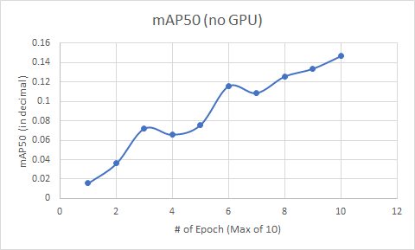
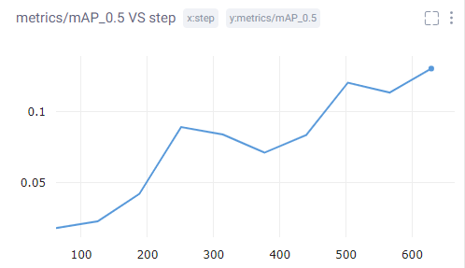
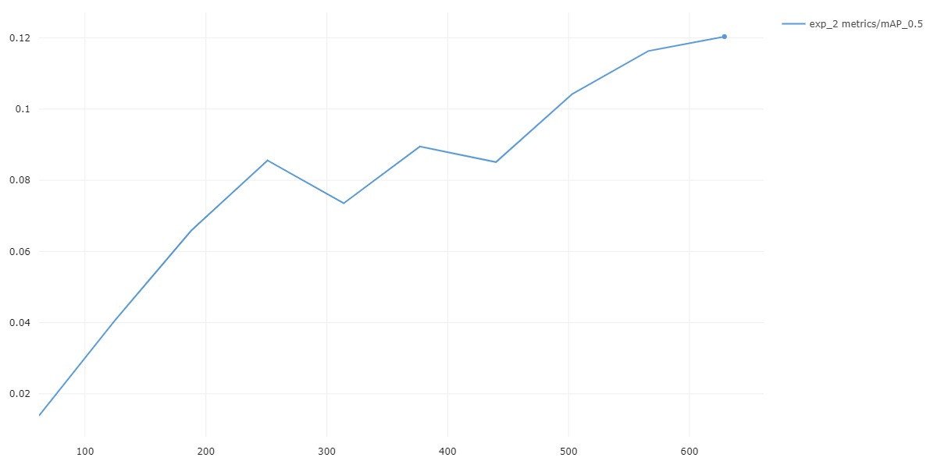
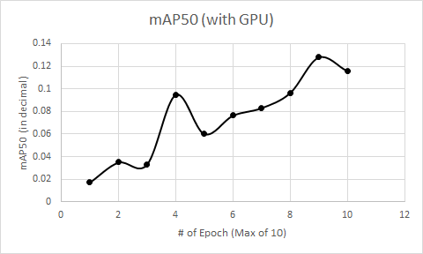
map50 graph results
2
1
4
3

Slide 13
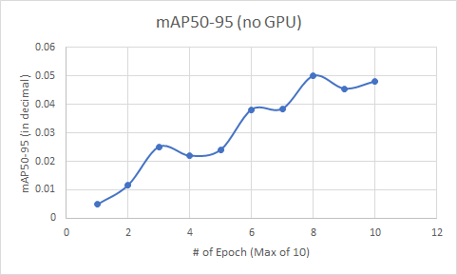
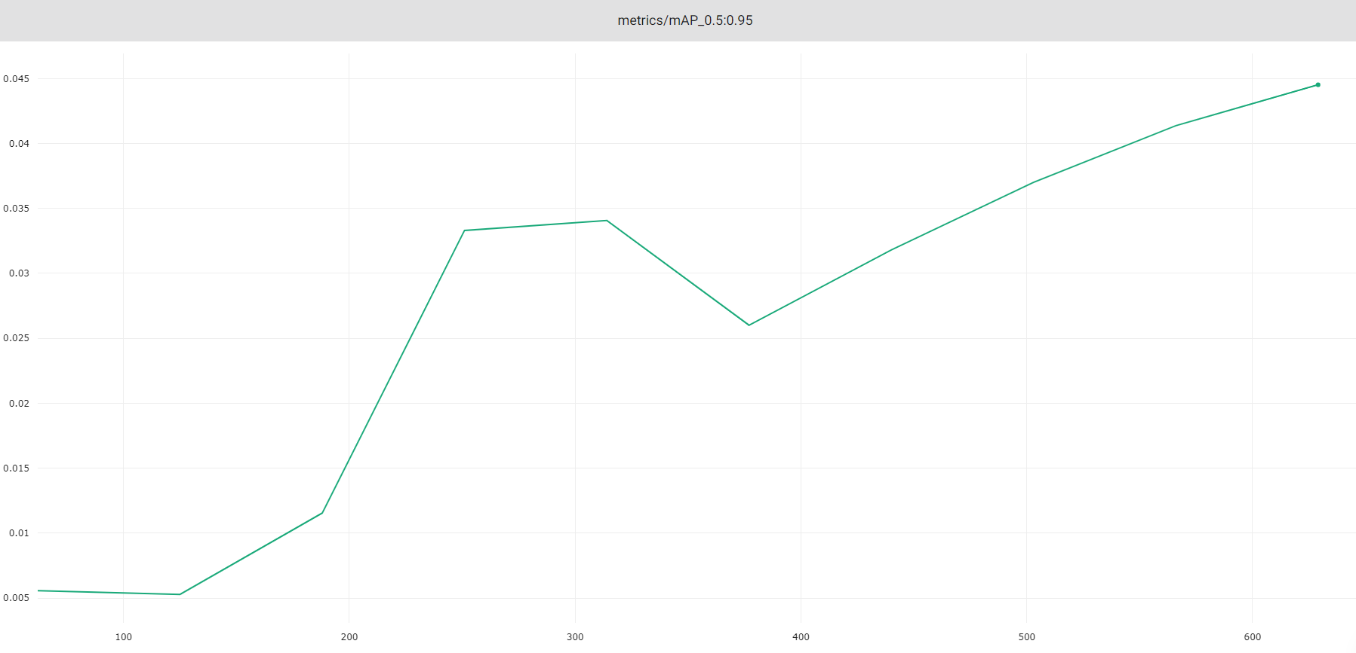
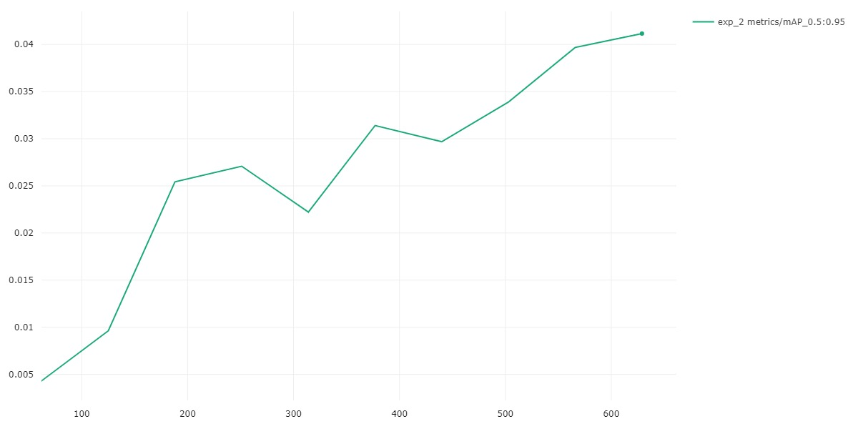
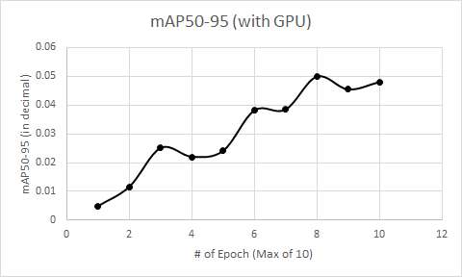
Map50-95 Graph Results
2
1
4
3

Slide 14
CPU Behavior

